Slide 1
Comparing Credit Availability Indices
June 2016

Slide 2
I. Problem We Are Trying to Fix: Dispersion Between MCAI and HPA2Yr
Dispersion Between MCAI and HPA2Yr
In our current model, we use HPA two-year moving average as a measure of market credit availability. However, comparing the Mortgage Credit Availability Index and HPA2Yr curves, we can see a dispersion between them after 2013. At the same time, our model tracking error goes up.
We might want to change the credit availability measure in our future version of model. MCAI would be a choice. In that case, since the MCAI is calculated by the origination information of all kinds of loan products(including non-agency products), we need to actively maintain the market share of different products.

Slide 3

II. Credit Availability Indices for The Horse Race 1. HPA 2Yr
The HPA 2Yr index is calculated based on HPI changes. We use the relative change between current month and two-year before. For example the HPA 2Yr for 2016/06 is:
$${HPA 2Yr}_{2016/6}=\frac{{HPI}_{2016/6}}{{HPI}_{2014/6}}$$

Slide 4
II. Credit Availability Indices for The Horse Race 2. MBA Credit Availability Index
The Mortgage Bankers Association (MBA) provides an MCAI that has an expanded historical series which gives perspective on credit availability going back approximately 10-years (the expanded historical series does not exist for product sub-types such as Conventional, Government, Conforming, or Jumbo).
The MCAI is calculated using several factors related to borrower eligibility (credit score, loan type, loan-to-value ratio, etc.). These metrics and underwriting criteria for over 95 lenders/investors are combined by MBA using data made available via the AllRegs® Market Clarity® product and a proprietary formula derived by MBA to calculate the MCAI, a summary measure which indicates the availability of mortgage credit at a point in time.

Slide 5
II. Credit Availability Indices for The Horse Race 3. MBA Purchase Index
The Mortgage Bankers Association’s weekly measurement of nationwide home loan applications based on a sample of about 75% of U.S. mortgage activity. Analysts consider the MBA Purchase Index to be a leading indicator of the housing market.
Purchase index is a function of housing inventory, so we need to adjust the index by the growth in total US housing inventory.

Slide 6
II. Credit Availability Indices for The Horse Race 4. Cello Mortgage Credit Availability Index
Cello MCAI is measured by cumulative default rate. The index applies different weights on FHA/VA/Conventional/Jumbo/Alt-A/Subprime. The parameters of the MCAI model are calibrated using the Agency loan-level Credit Data set.

Slide 7
II. Credit Availability Indices for The Horse Race Normalized Indices
In order to compare all the four indices, we normalized them all to a 0-100 range. The minimum number is set to 0, and the maximum is set to 100. All curves are smoothed by taking two-year moving average.
Notice the different peaks: does Credit Availability peak at the beginning of 2006 or the end of 2006? Similar question about troughs.
Note the dispersion among the different indices post-2010. Clearly, HPA 2-year is an outlier.

Slide 8

III. The Horse Race Framework
In order to compare all the four indices, we normalized the curves in a 0-100 range. The minimum number is set to 0, and the maximum is set to 100. Additionally, all curves are smoothed using a two-year moving average (we will examine lag effects later).
Refi Module
Horse Race Framework
S-Curve
11 Parameters
3 Parameters
Automatic Curve Optimization
S Curve
Media Effect
Credit Availability
WALA
Burnout
Loan size
CLTV(Normal / HARP)
HARP-Eligible
Refi-Elig %
HARPed %
TPO %
S Curve
Media Effect
Generalised logistic function
Fixed
$$Y\left(t\right)=A+\frac{K−A}{{(C+Qe^{−B(t−M)})}^{1/ν}}$$
Credit Availability
HPA2Yr
MBA MCAI
Purchase Index
Cello MCAI
A: the lower asymptote
K: the upper asymptote.
B : the growth rate
nu: affects near which asymptote maximum growth occurs
Q : is related to the value Y(0)
Don’t use in the Horse Race
Optimization – Least Square
Compare Tracking Root Mean Squared Error (RMSE)

Slide 9
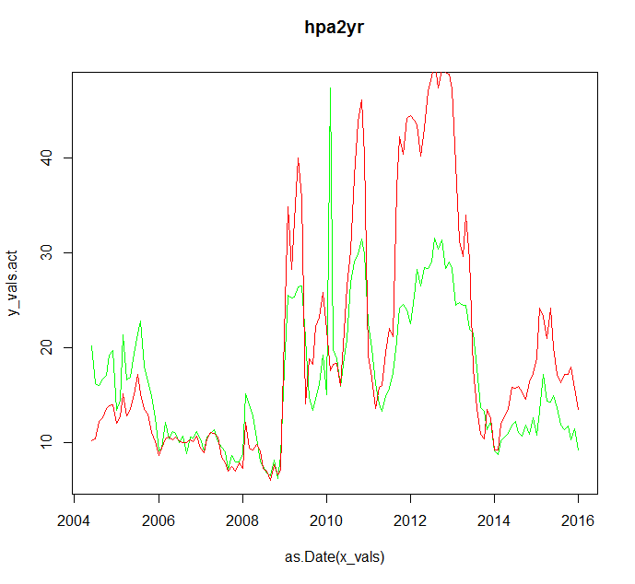
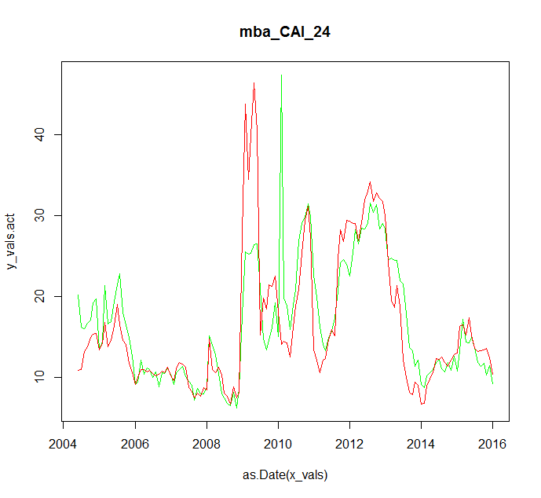
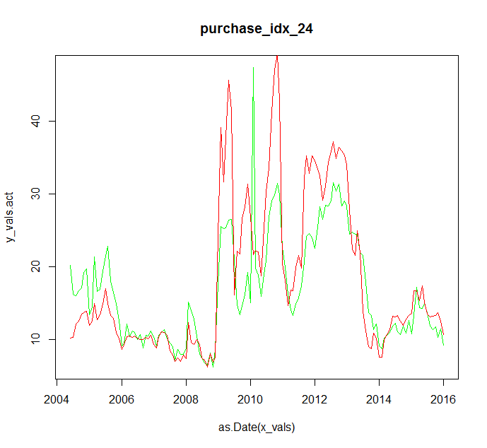
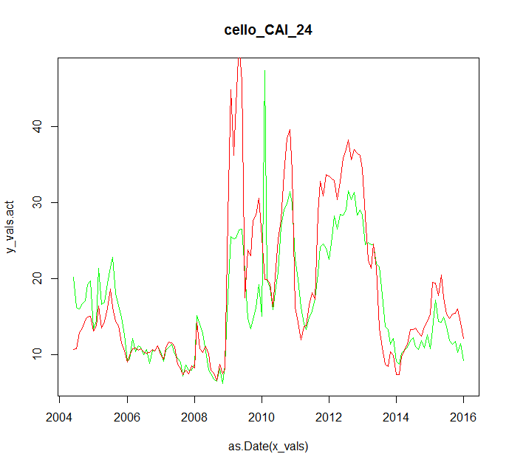
IV. Results
RMSE = 7.9710e-2
RMSE = 7.7610e-2
RMSE = 7.8410e-2
RMSE = 7.8410e-2
Using the four candidate CAIs, we tested the tracking from 2004 to 2016. The total RMSE shows the three new curves have better fits compared with the HPA-2yr index. The MBA CAI has the best performance among the four.

Slide 10
IV. Result Analysis Tests for Different Moving Average Lags
Different time lag
The normalized curves have different time lags. So, potentially, that will affect our tracking result.
In order to avoid the bias and find out the best moving average range for each one of the curves, we tried moving averages for 24 months, 18 months, 12 months and 6 months.

Slide 11
IV. Result Analysis Test for Different Moving Average Lags
 | mba_CAI | purchase_idx | cello_CAI
24 Month | 0.0775741 | 0.0784130 | 0.0783926
18 Month | 0.0770801 | 0.0787880 | 0.0777685
12 Month | 0.0791511 | 0.0791555 | 0.0862411
6 Month | 0.0783332 | 0.0807010 | 0.1008529
From the RMSE numbers showed above, the best combination is MBA MCAI with 18 month moving average.
All the three curves with moving average of 24 or 18 month have a good performance in the tracking test. We can choose one of them based on other considerations, such as the difficulty of obtaining data.

Slide 12
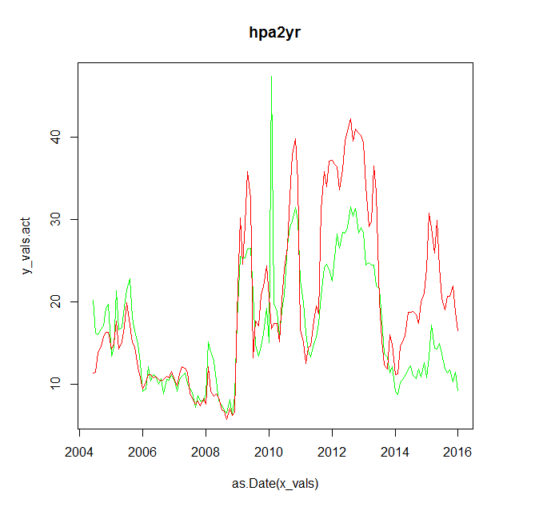
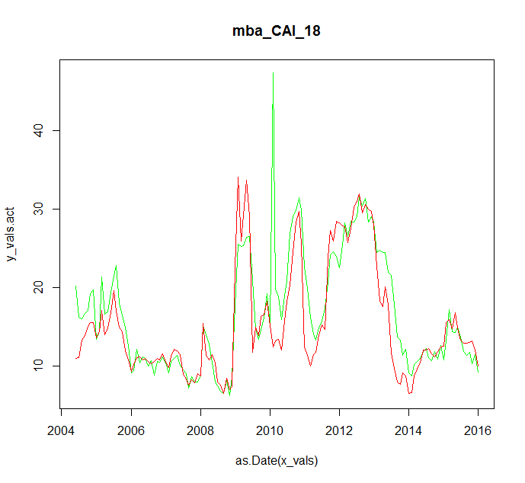
V. Potential Improvement
Tracking Result Using Current HPA2Yr Model
Tracking Result Using MBA MCAI 18 Month
From the charts, we can see a clearly potential of improvement of model fitting. Especially, the issue that model tracking is too fast after 2014 will be fixed.

Slide 13
VI. Backfill MBA CAI Using Purchase Data
Using a simple linear regression on Purchase data set, we can back fill the MBA-CAI time series historical data.

